Slide 1

Kavya Amballa

Slide 2



Low Adoption Success
Many animals remain unadopted or are returned due to mismatched expectations, age, breed bias, or behavioral issues.
Shelter Strain
Overcrowded, underfunded shelters struggle to manage intake and long-term care.
Lack of centralized data makes monitoring and planning difficult.
Stray Animal Crisis
India has a large population of stray and abandoned dogs and cats, overwhelming shelters in major cities.

Slide 3
PURPOSE
Driving Adoption Success Through Data
Increase Adoption Rates: Analyze patterns across shelters to understand what drives successful adoptions for dogs and cats.
Reduce Returns: Identify root causes of failed adoptions and design strategies to lower return rates and improve welfare.
Optimize Shelter Operations: Monitor shelter occupancy and staff ratios to allocate resources where they are most needed.
Understand Adopter Behavior: Analyze demographics, preferences, and motivations to better align animals with adopters.
Enable Predictive Insights: Use data-driven forecasting to anticipate adoption demand, shelter strain, and foster program needs.

Slide 4
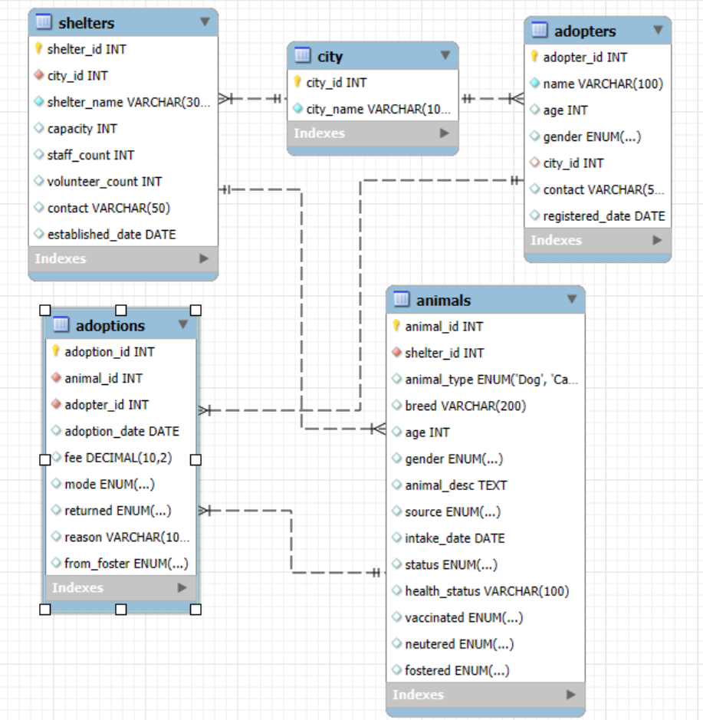
DATA & RELATIONS
Visual Representation of Entities and Their Connections
This ERD shows the design of a database for an animal shelter or adoption service. It consists of five main tables:
Shelters: Stores details about each animal shelter.
City: Contains a list of cities .
Adopters: Holds information about individuals who adopt animals .
Animals: Provides comprehensive data on each animal who been in shelter .
Adoptions: Records each adoption event as a transaction .

Slide 5
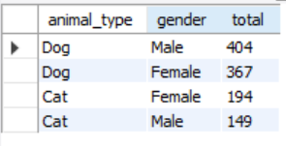
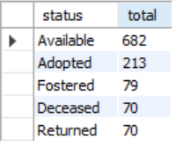
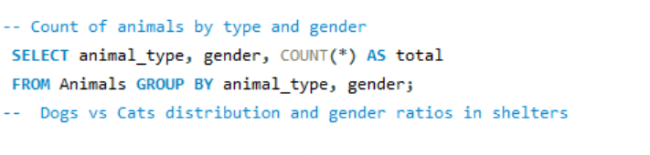
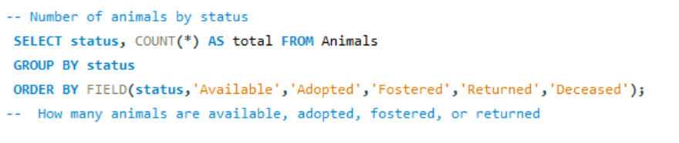
PHASE 1 : DATA EXPLORATION
Understanding the Baseline: Animals, Adopters, and Sources
Animal Distribution
Dogs dominate shelter populations .
(771 vs. 343 Cats) with a slight male skew.
Highlighting the need for dog-focused resources and campaigns for cats
Adoption Status
Of ~1114 animals, only 213 (≈19%) adopted.
682 remain available, with 70 returned had a significant welfare concern.

Slide 6
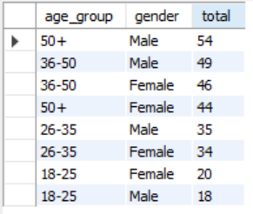
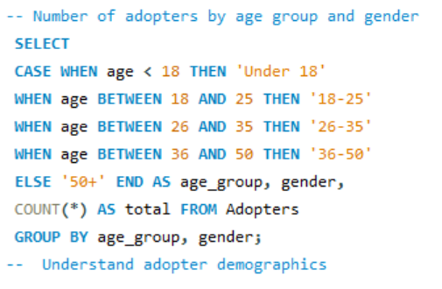
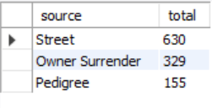

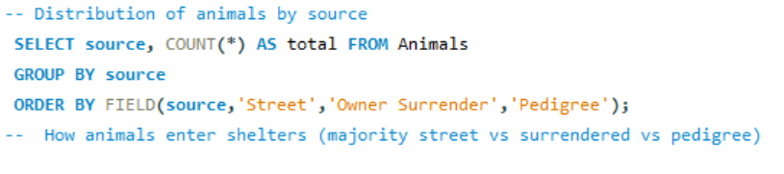
PHASE 1 : DATA EXPLORATION
Understanding the Baseline: Animals, Adopters, and Sources
Adopter Demographics
Majority of adopters are 36+ years
Younger age groups (18–25) underrepresented in adoptions.
Source of Animals
Street rescues form the bulk (630)
Compared to owner surrenders (329)
Pedigrees (155) reinforcing stray crisis.

Slide 7
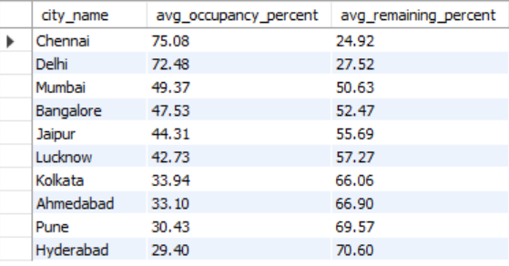
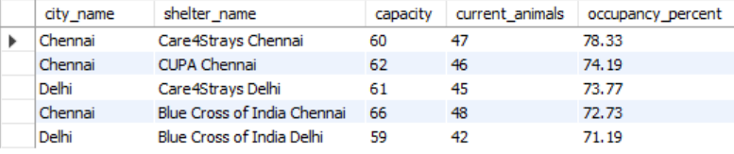
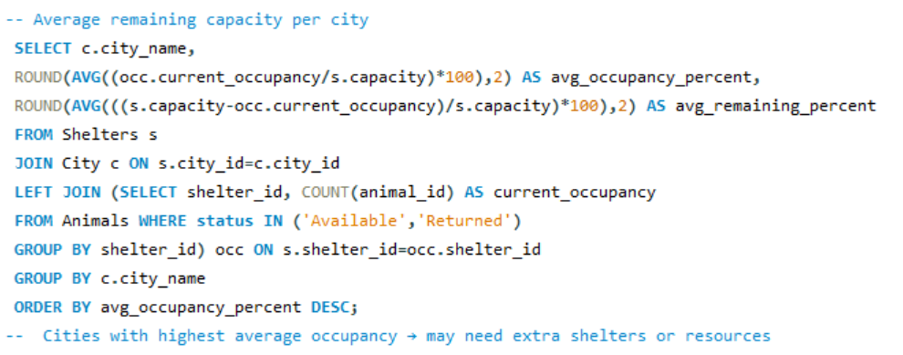


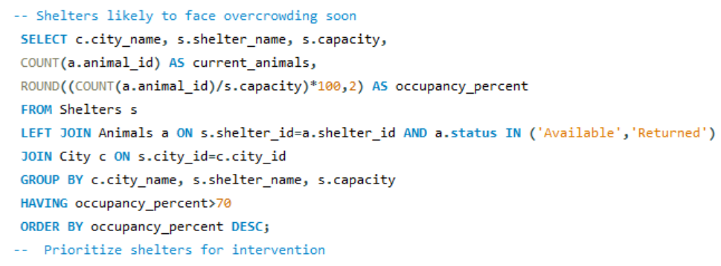
PHASE 2 : SHELTER OCCUPANCY
Identifying Strain Hotspots Across Cities
Overloaded Cities
Chennai (~75% occupancy)
Delhi (~72%) face critical strain compared to underutilized shelters in Pune and Hyderabad (<35%).
High-Risk Shelters
Blue Cross Chennai (78.7%)
Care4Strays Chennai (78.3%)
CUPA Chennai (74.1%) nearing full capacity.

Slide 8
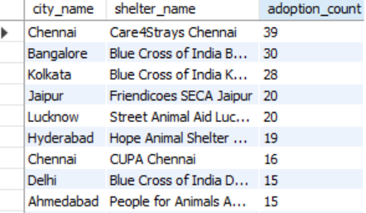
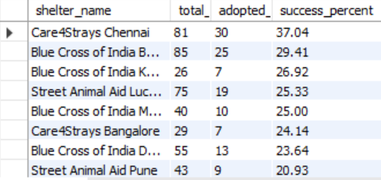
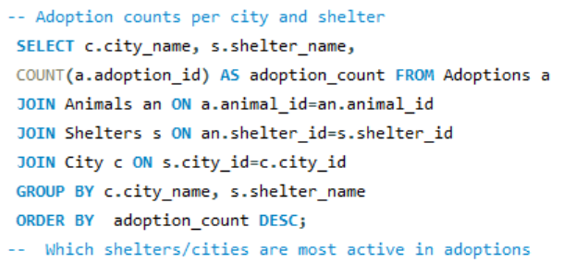


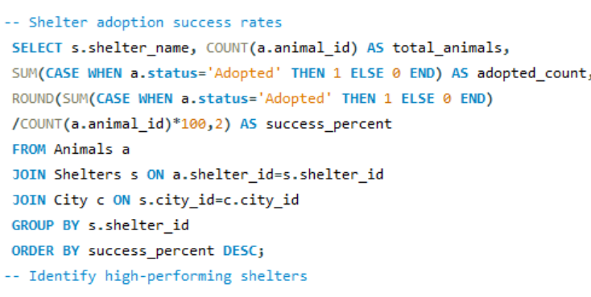
PHASE 3 : ADOPTION OUTCOMES
Trends in Adoption Success and Animal Preferences
Top Adoption Hubs
Chennai (Care4Strays – 39), Bangalore (Blue Cross – 30), Kolkata (Blue Cross – 28)
Lead in adoption counts, indicating concentrated adoption activity in a few shelters.
Success Rates
Wide disparity across shelters
Care4Strays Chennai reaches 37% success while Blue Cross Hyderabad reports 2% , showing uneven performance.

Slide 9
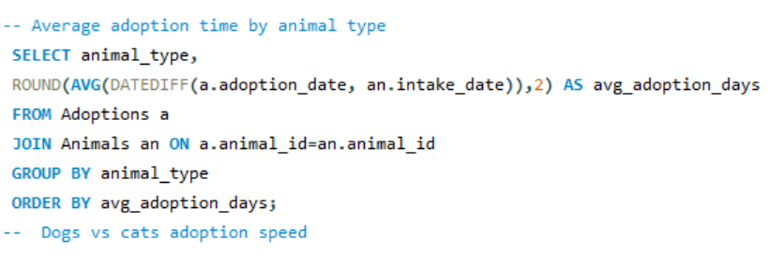
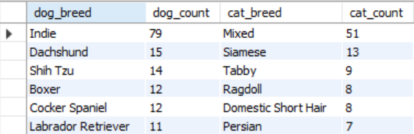
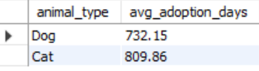

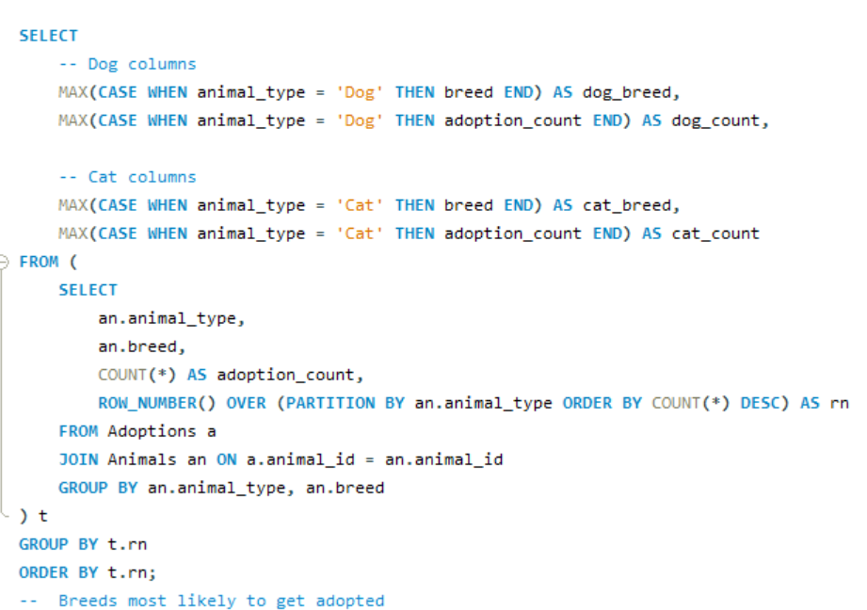
PHASE 3 : ADOPTION OUTCOMES
Trends in Adoption Success and Animal Preferences
Adoption Speed
Dogs are adopted in ~732 days, slightly faster than Cats (~810 days).
Yet both remain excessively long wait times, often over 2 years.
Breed Bias
Dogs: Indies (79), Dachshunds (15), Shih Tzus (14).
Cats: Mixed (51), Siamese (13), Tabby (9).
Preferences shape adoption outcomes.

Slide 10
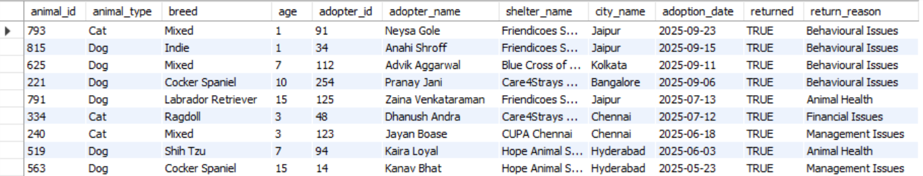

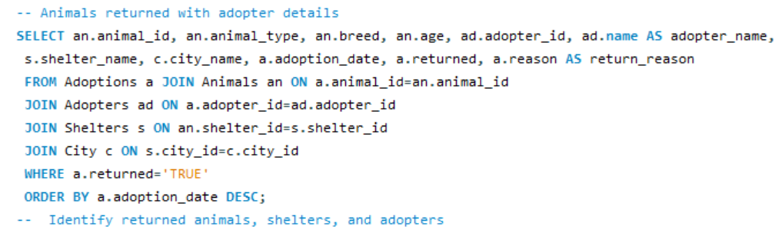
PHASE 4 : CHALLENGES & RETURNS
Understanding Why Adoptions Fail
Adoption Failures
This identifies animals that were returned after adoption, along with adopter and shelter details.
It helps understand patterns in returns, to reduce adoption failures and improve matching.

Slide 11
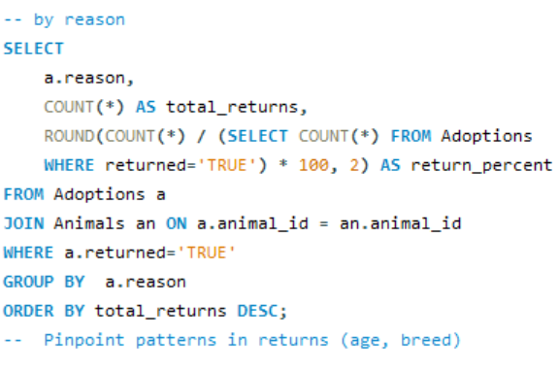
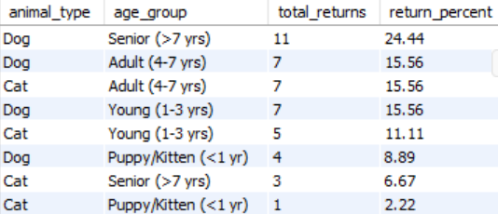
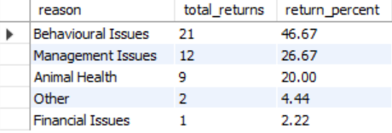

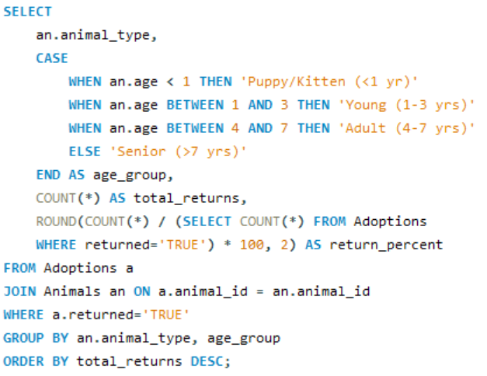
PHASE 4 : CHALLENGES & RETURNS
Understanding Why Adoptions Fail
Return Rates
Behavior : 47% of returns are linked to behavior problems.
Management : 27% of adopters return pets due to lack of time, space.
20% of returns due medical issues
Risk Groups
Senior dogs (>7 years),
Adult cats (4–7 years),
Indies, and Mixed cats face the highest risk of being returned.

Slide 12
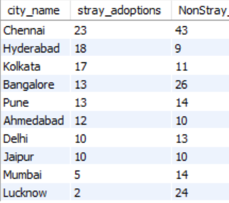
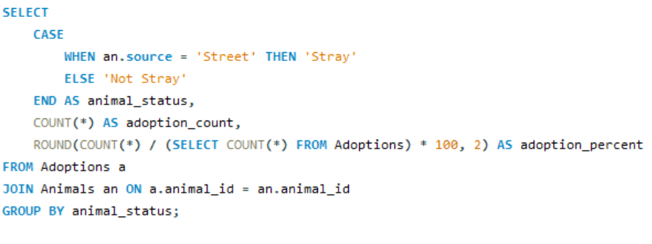
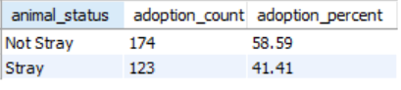

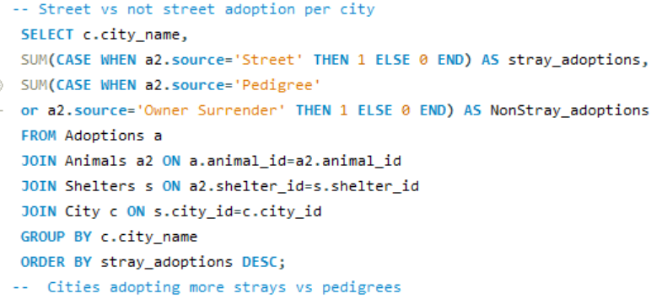
PHASE 5 : STREET VS PEDIGREE
Adoptions Preferences Across Cities
Adoption Split
Strays account for 41.4% of adoptions.
While pedigrees and owner surrenders form 58.6%.
Showing a clear Bias & Lower adoption of strays highlights need for ‘Adopt a Desi’ awareness
Cultural Patterns
Urban centers like Delhi, Mumbai, and Lucknow lean heavily toward pedigrees
While Kolkata and Hyderabad demonstrate more balanced adoption behavior.

Slide 13
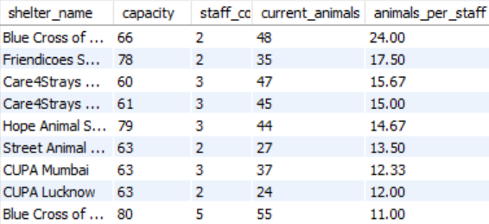
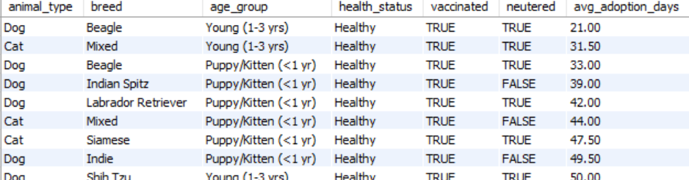
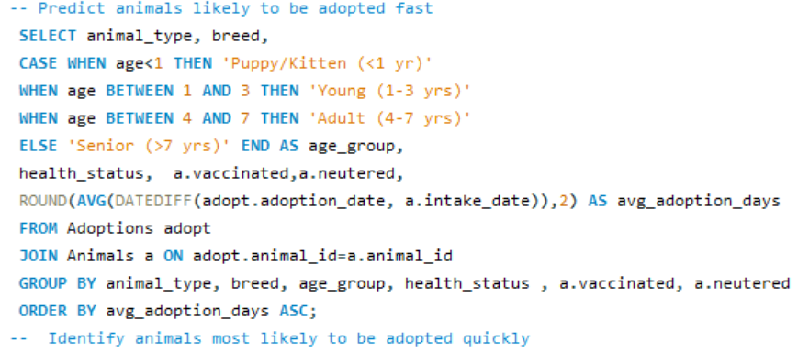


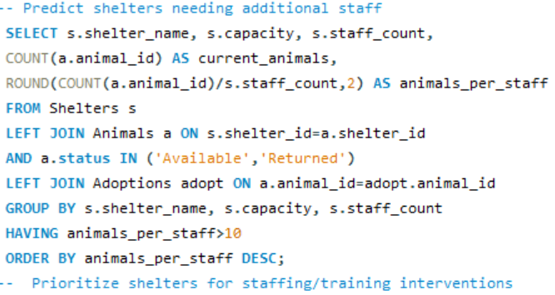
PHASE 6 : MORE INSIGHTS
Moving Beyond Descriptive Analysis
Adoption Speed
Young, healthy, vaccinated and neutered animals adopted within 21–31 days
While Seniors and Indies waiting 500–1000+ days.
Shelter Strain
Blue Cross Chennai 24 animals per staff & also has less staff count respective to count of animals
Situations like this lead to resource bottlenecks.

Slide 14
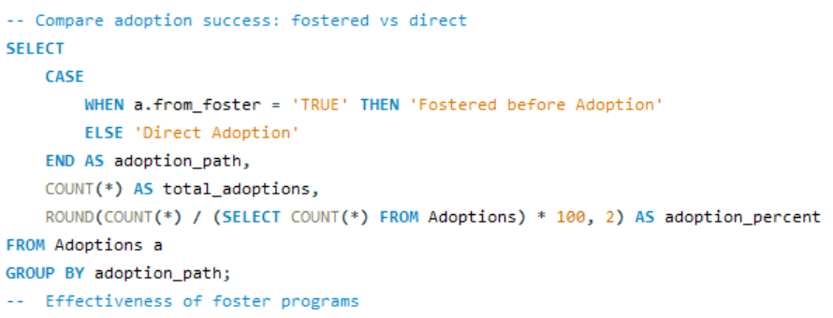
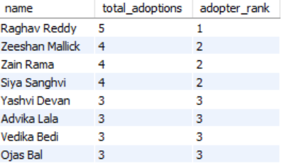
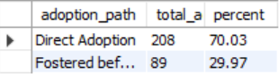


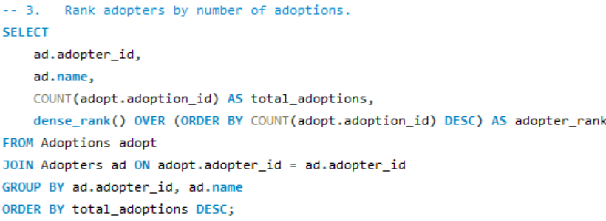
PHASE 6 : MORE INSIGHTS
Moving Beyond Descriptive Analysis
Foster Program Impact
Currently 30% of adoptions come via fostering
Scaling this pipeline could ease shelter load and improve outcomes.
Super Adopters
A small group of adopters (5+ animals)
Can be nurtured as ambassadors, donors, or foster leaders.

Slide 15
Strategic Action Roadmap
Integrating Key Actions Across All Phases
Engage Younger Demographics: Target campaigns at 18–25 year olds through digital platforms, colleges, and influencer-driven adoption stories.
Balance Shelter Capacity: Redistribute animals, expand fostering, and invest in infrastructure to reduce overcrowding in Chennai & Delhi.
Improve Adoption Outcomes: Support underperforming shelters, design cat-focused campaigns, and address breed biases to cut wait times, Scale ‘Adopt a Desi’ campaigns.
Reduce Returns: Offer behavioral training, enhance adopter screening, and provide transparent health disclosures with vet support.
Leverage Predictive Insights: Use data to forecast shelter strain, expand foster programs, and engage ‘super adopters’ as ambassadors.

Slide 16
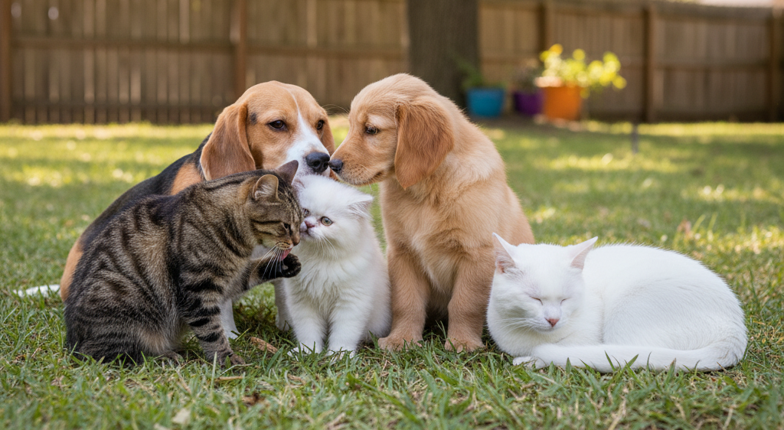
Conclusion & Future Scope
Towards Smarter, Kinder Adoptions
This analysis makes it clear: adoption success isn’t just about finding homes it’s about smarter planning.
With only 1 in 5 animals getting adopted and some shelters operating at over 70% capacity, the gaps are evident.
Returns linked to behavior and mismatched expectations highlight the need for better adopter alignment. At the same time, 30% of adoptions already come through fostering, proving the potential of scalable programs. These insights show how data can drive practical change helping shelters cut wait times, balance resources, and ensure more animals find lasting families.
For the future, we can focus on better awareness campaigns, improving foster programs, and helping more strays find loving homes.

Slide 17

THANK YOU
For your time and attention

